Slide 1
Business Analytics Team focusing on Remote Sensing Support (RSS)
Notes:
Makayla

Slide 2
Meet the Team
Meet Our Sponsors
Introducing our project
Understanding the Problem
Manual Process Before PowerBi
Project timeline
User Requirements
Our Powerbi Solution
Initial Setup and Design Direction
Final Deliverables
Demo
Key Takeaways
Thank you
AGENDA
Notes:
Rachit

Slide 3




Meet the team
Nhat Phan
Prathik Tippur
Makayla Johnson
Rachit Kowatra
Project Lead / Power BI Developer
Workflow & Integration Support
Data Analyst & Documentation Lead
Testing & Quality Assurance Specialist
Notes:
All talk

Slide 4


Meet Our Sponsors
Justyna Grinholc
Rebecca Spring
Program Director at Evergreen
Project Manager
Notes:
Makayla

Slide 5
Introducing Our Project
Problem
Weekly project updates were sent via email and manually copied into a SharePoint document — a process that was inefficient and time-consuming.
Our Project
We were assigned to design a more efficient system using Power BI that would allow team members to submit their weekly updates directly, enabling an automated, centralized report.
Solution
Our project aims to cut down manual steps, reduce errors, and improve access to real-time status updates.
Notes:
Prat

Slide 6
Understanding the Problem
01
02
03
04
05
Analysis
Brainstorming
Idea
Teamwork
Solve
We started by reviewing the current SharePoint workflow and understanding the time-consuming manual tasks involved.
Rebecca expressed the need for a more streamlined process. She mentioned Power BI as a potential tool to improve reporting.
This discovery phase set the foundation for our solution and gave us a clear direction.
From there, we considered how we could connect weekly updates directly to Power BI, reducing the need for emails and
manual entry.
Our team collaborated with stakeholders to gather requirements, explore feasibility, and map out the existing workflow.
Notes:
Prat

Slide 7
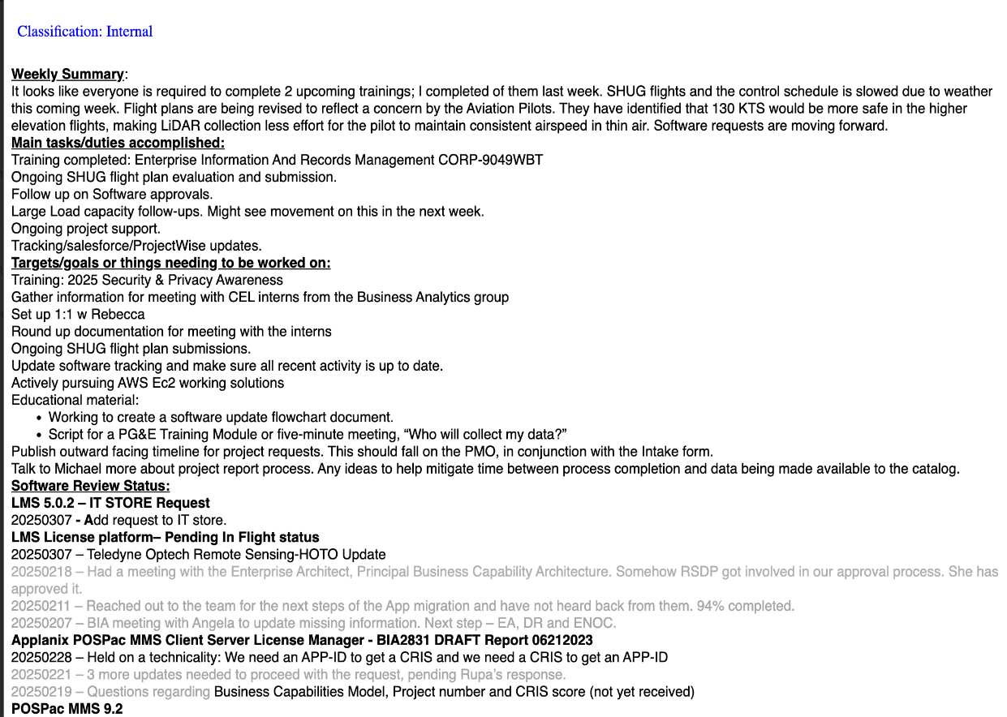
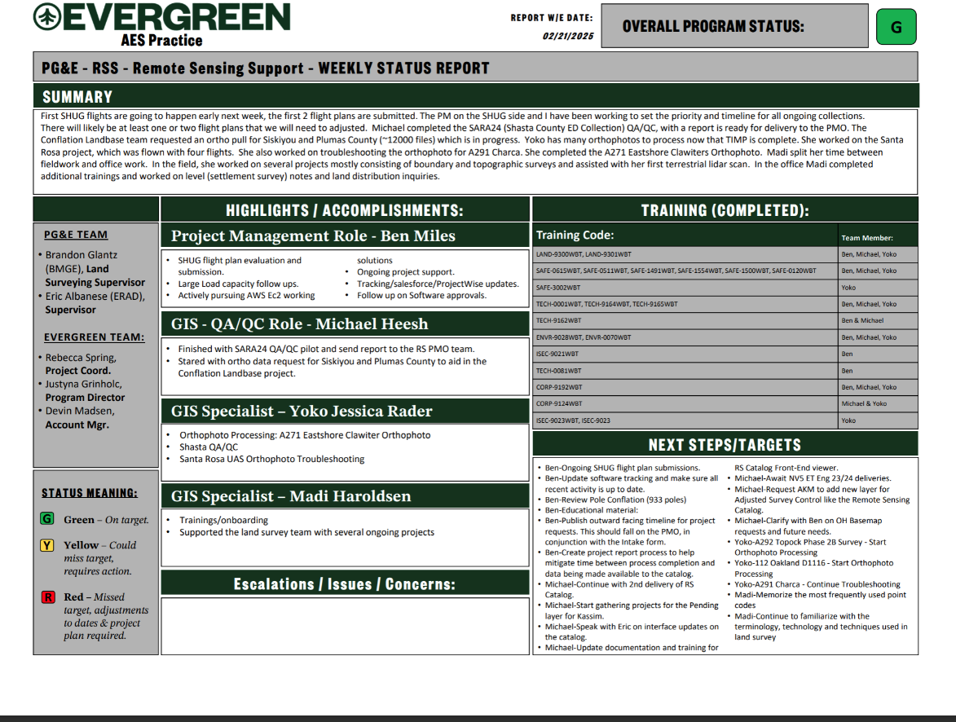
Manual Process Before PowerBI
Email Submissions Each Week
Manually Compiled Weekly Report
Notes:
Rachit

Slide 8
Project Timeline
Feb 26: Project Kickoff
1
Met with clients, received project assignment details
2
Mar 3 - Mar 14: Planning & Requirements
Defined objectives, gathered data sources, and stakeholder meetings
Mar 20 - Apr 7: Development Phase
3
Power BI workspace setup, data model creation, dashboard mockups
4
Apr 8 - Apr 14: Testing Phase
Troubleshooting data connection issues and iterative improvements
Apr 14 - Apr 18: Gathering Feedback
5
Quality assurance checks, data validation, final design
6
Apr 21 - Apr 25: Presentation Prep
Slide creation, mock presentations, getting ready for final presentation
Apr 28: Insight Global Presentation
7
In-person presentation to key stakeholders
Notes:
Rachit

Slide 9
User Requirements
Shared Input Method
Users must be able to enter updates into a centralized Excel file without needing technical skills.
Automated Dashboard Updates
Information entered into the Excel file should automatically update the Power BI dashboard in real time or on a refresh schedule.
Metrics Tracking
Users should be able to view key metrics.
Secure and Controlled access
Only authorized team members should be able to view and edit the Excel file and dashboard.
User Friendly Interface
The dashboard must be intuitive and easy to navigate so stakeholders can quickly interpret project data.
Notes:
Makayla

Slide 10
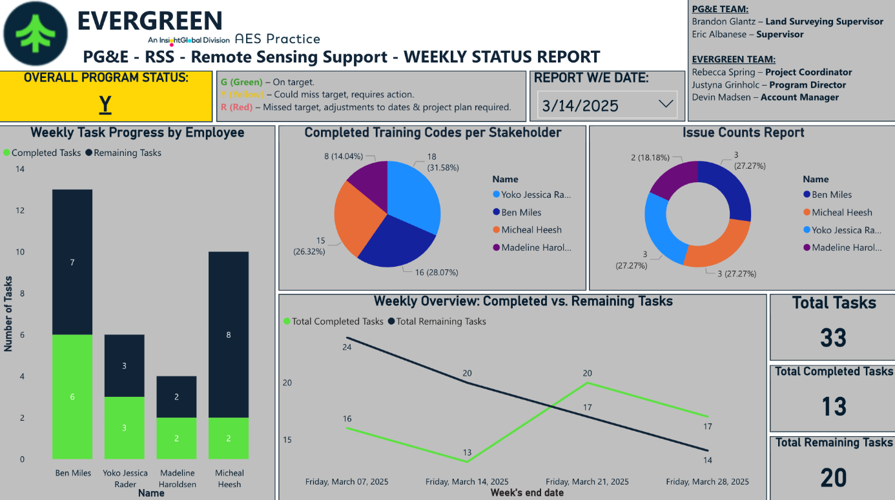
Our Power BI Solution
Data Source: Shared Excel file that all team members can update
Live Dashboard: Automatically reflects real-time updates
Visuals: Tracks status, metrics, and team progress
Access: Limited to stakeholders for security and transparency
Automation: Power Automate sends weekly report link to stakeholders on a set schedule
Notes:
Makayla

Slide 11
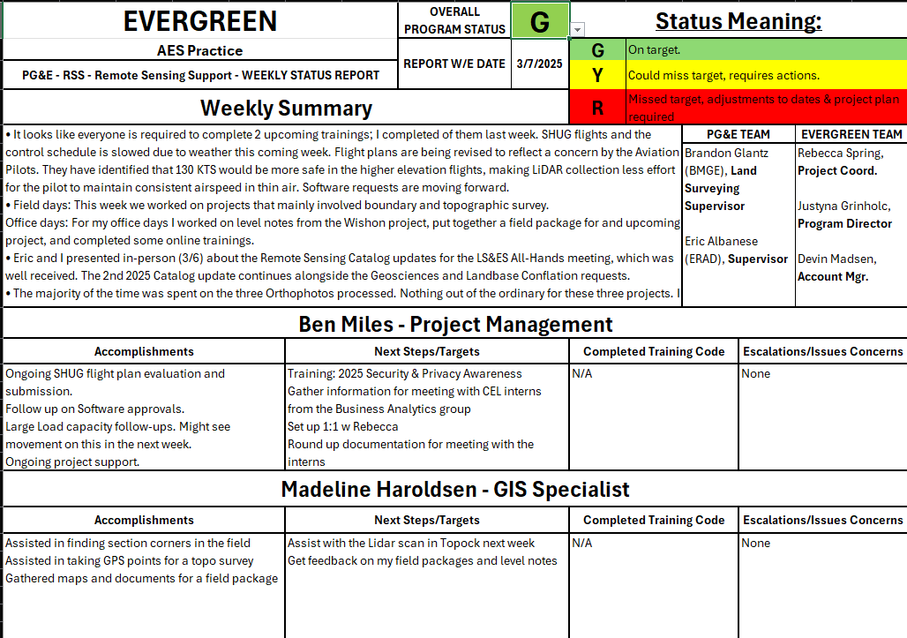
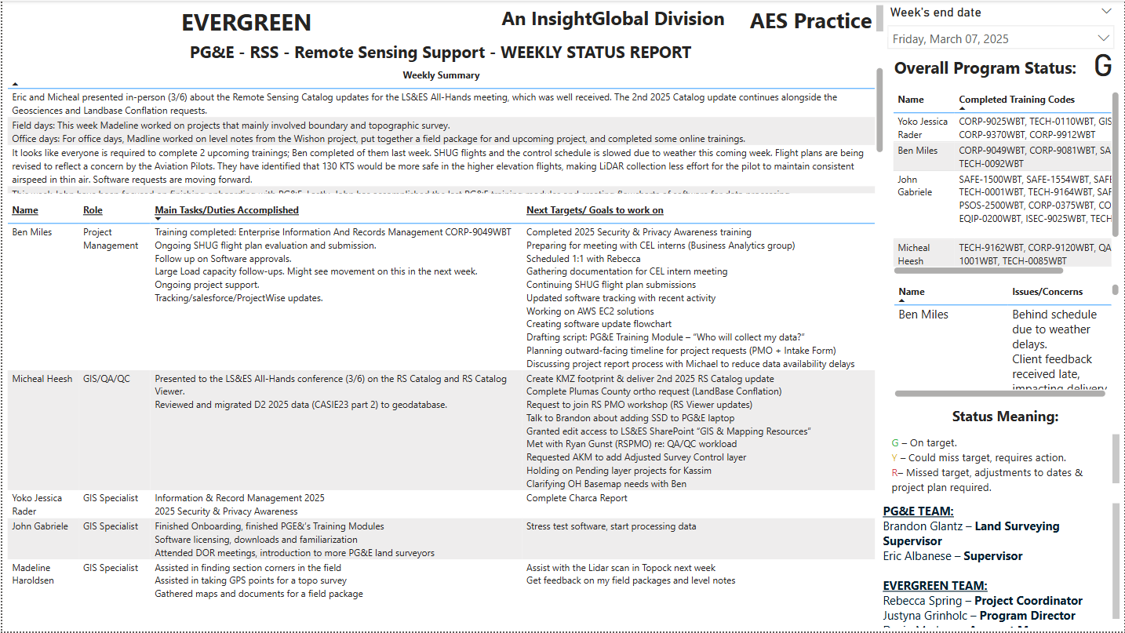
Initial Setup & Design Direction
Notes:
Nhat

Slide 12
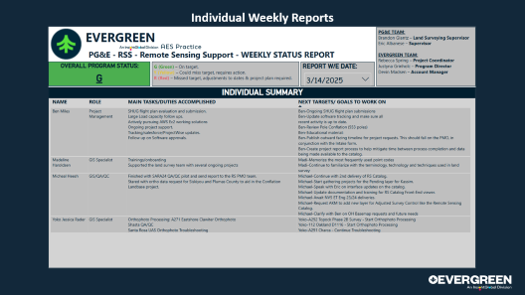
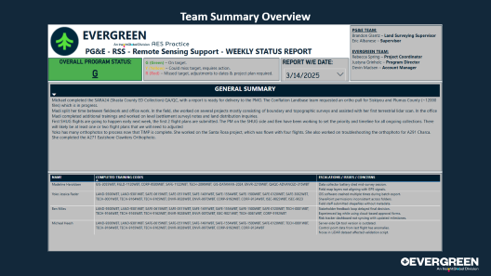
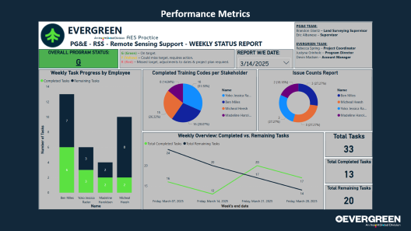
Final Deliverables (Part 1)

Slide 13
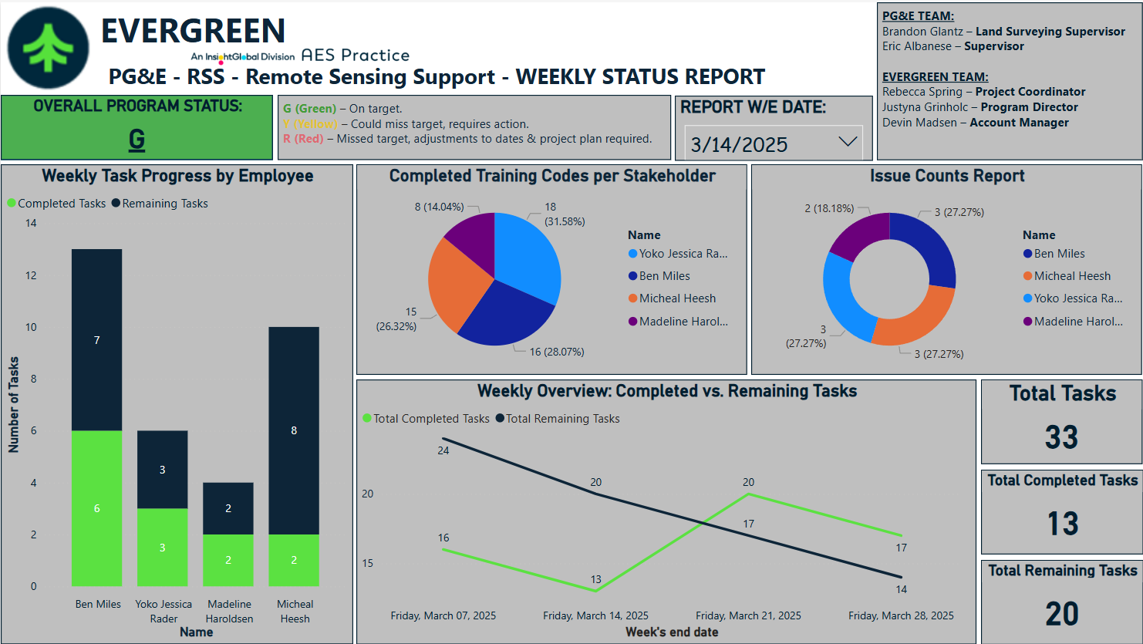
Performance Metrics
Notes:
Nhat

Slide 14
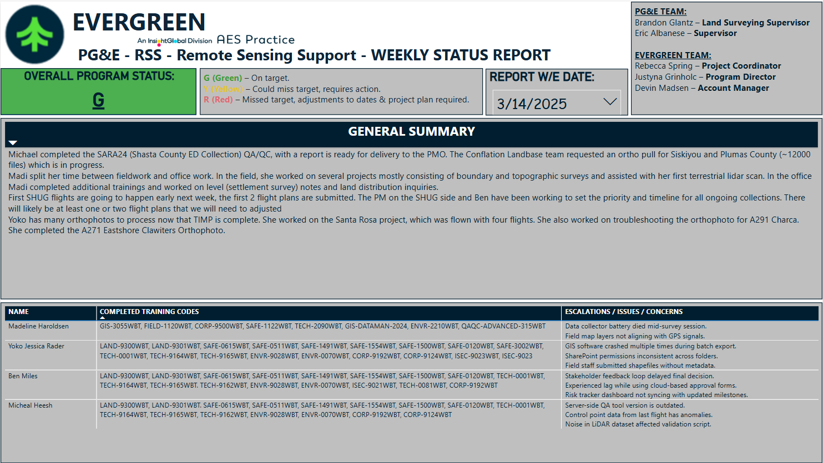
Team Summary Overview
Notes:
Nhat

Slide 15
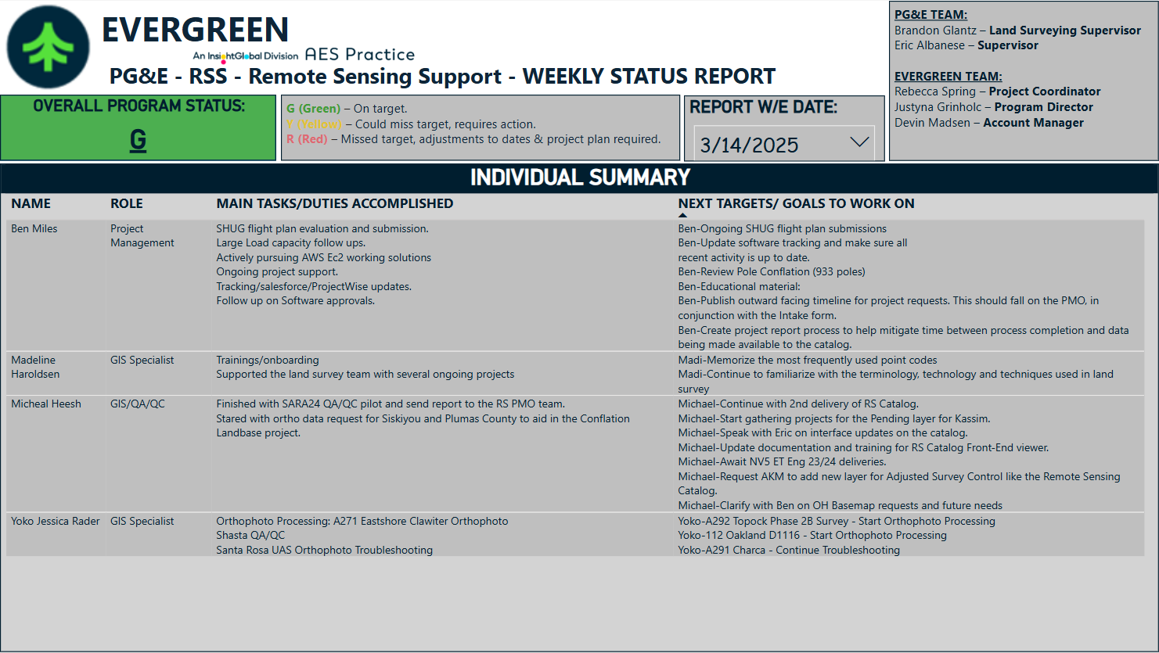
Individual Weekly Reports
Notes:
Nhat

Slide 16
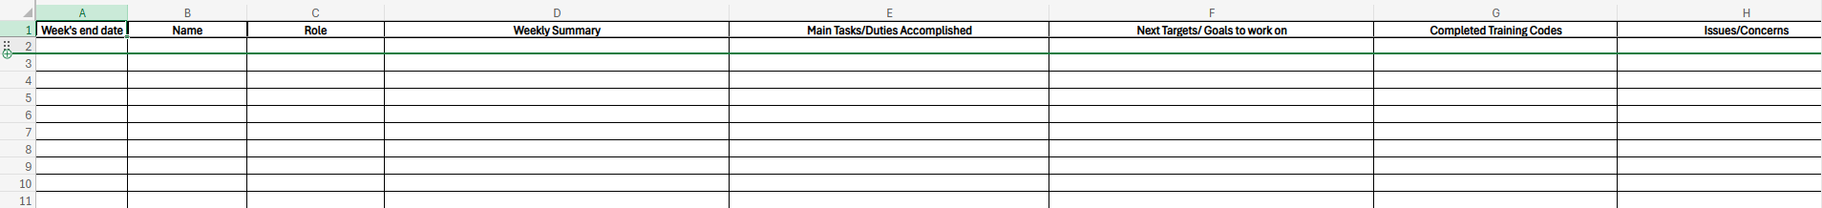
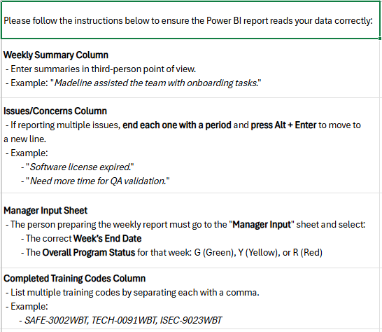
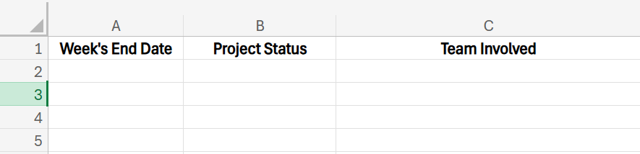
Final Deliverables (Part 2)
Weekly Summary
Read Me
Manager Input
Notes:
Nhat

Slide 17
Demo
Demo video
Sample exported PDF report
Notes:
Nhat

Slide 18






Conclusion
Key Learning
Future Recommendation
Structured and Reliable Data Input
Interactive, Insightful Dashboard Design
User-Friendly and Branded Experience
Scalable for future automation features
Recommend assigning a technical contact for tool-specific guidance
Ensure proper domain’s accessibility
Notes:
Nhat

Slide 19
Andrew Covel
Paolo Hernandez
Jacob Gomez
Prayag Padwal
Notes:
Nhat

